Slide 1
Pathophysiology and Reperfusion Injury
Student’s Name
Institutional Affiliation

Slide 2
Introduction
The presentation provides a conceptual framework about pathophysiology of reperfusion injury.
Pathophysiology refers to functional changes that occur in the body after an injury.
Reperfusion injury refers to tissue damage that results from blood supply returning to tissue after a period characterized by lack of oxygen.
Blood flow is restored to the damaged tissue causing further damage.

Slide 3
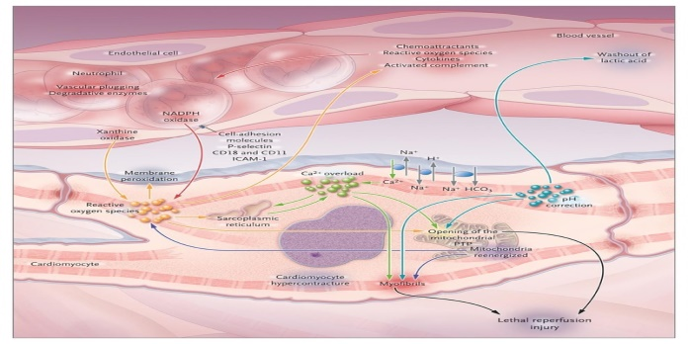
Cont.
As a result, a paradoxical effect results known as reperfusion injury.
Reperfusion injury is a complex interaction between intercellular calcium and free radicals of oxygen.
The result is acceleration of myocardial damage.
Death, fatal arrhythmias, and micro-vascular dysfunction can occur in the process.

Slide 4
Cont.
Nitric oxide is a relaxing factor that is produced from the endothelium.
It counters the effects of reperfusion injury.
Nitric oxide inactivate the free oxygen radicals.
As a result, it ameliorates the reperfusion injury process.

Slide 5
Reactive Oxygen Species (ROS)
ROS plays an integral part in reperfusion.
They have a destructive role since they mediate tissue damage.
Ischaemic tissue is reperfused and molecular oxygen influx occurs.
Consequently, xanthine oxidase is catalyzed to degrade hypoxanthine to create uric acid.

Slide 6
Cont.
Highly reactive superoxide anion is liberated.
The superoxide is converted hydrogen peroxide and hydroxyl radical.
The production of hydroxyl radical peroxides lipid structures of the cellular membrane.
Proinflammatory eicosanoids are produced systematically.

Slide 7
Cont.
Cell permeability is disrupted and cell death results.
ROS activates endothelial cells.
Transcription factor activity is elevated to stimulate the endothelial cells t to produce E-selectin, intercellular adhesion molecule, vascular cell adhesion molecule, plasminogen activator inhibitor, and endothelial-leukocyte adhesion molecule (Cowled & Fritdge, .
The adhesion molecules lead to essential interactions between endothelium and neutrophil.

Slide 8
Cont.
Superoxide anions are detected within the venous effluent and ischaemic muscle.
The superoxide induces damage on additional organs during the process.
Xanthine oxidase reduces the production of superoxide.
As a result, it reduces the severity of the superfusion injury.

Slide 9
Loss of Ion Homeostasis
Reoxygenation causes the reactivation of contractile activity.
High concentration of intracellular calcium ions creates contractile force in the presence of ATP.
The loss of calcium ions cause homeostasis to begin during ischemia process.
During Ischemia, there is a sustained increase of increase of sodium ions.

Slide 10
Cont.
Cytosolic acidification occurs due to anaerobic glycolysis.
The cell strive to correct sodium ion overload.
Reverse mode is activate during sodium and calcium ions’ exchange.
As a result, there is a progressive loss of calcium ions (Meana & Dorado, 2009).

Slide 11
Cont.
Reoxygenation of cells causes precipitation and worsening of cation control.
The return of blood results in the washing out catabolites.
A pH gradient is formed between the cell and its environment.
As a result, intracellular acidosis is corrected through the cellular membrane.

Slide 12
Cont.
The corrective response makes intracellular acidosis even worse.
Reverse exchange of sodium and calcium ions is activated.
The reverse mode has less significant impact on physiological conditions in myocytes.
A chain of correction mechanisms only cause calcium ions to accumulate.

Slide 13
Cont.
The reoxygenated cell becomes seriously compromised.
The cell swell and become structurally-fragile.
Swelling is due to the washing out of metabolites existing in the extra-cellular spaces.
Existing osmotic gradient cause water to enter the cell rapidly.

Slide 14
Reference
Fitridge R. & Thompson, M. (2011). Mechanisms of vascular disease. Adelaide, Australia: Barr Smith Press, 1-589.
Meana, M. & Dorado, G. D. (2009). Pathophysiology of ischemia-reperfusion injury: New therapeutic options for acute myocardial infraction. Cardologia, 62(2), 199-209.

